Slide 1
KMOU Division of Marine System Engineering
Introduction to
Internal Combustion Engine

Slide 2
Lesson content for each week
Ch0_Introduction to the Class | Ch6_Piston Fittings and Crankshaft
Ch1_Overview of the Internal Combustion Engine | Ch7_Lube Oil System
Ch2_Thermodynamics and Compressed Air System | Ch8_Cooling Water System
Ch3_Marine Fuels and Internal Fuel Oil System | Ch9_Introduction to the Main Engine
Ch4_Intake and Exhaust System | Ch10_Alternative Fuels and Alternative Fuel Systems
Ch5_Turbocharger | Ch11_Environmental Regulations and Exhaust Gas Aftertreatment Systems
Midterm | Ch12_Tools, Apprentice Engineer Duties, and Career Direction
 | Final Exam

Slide 3
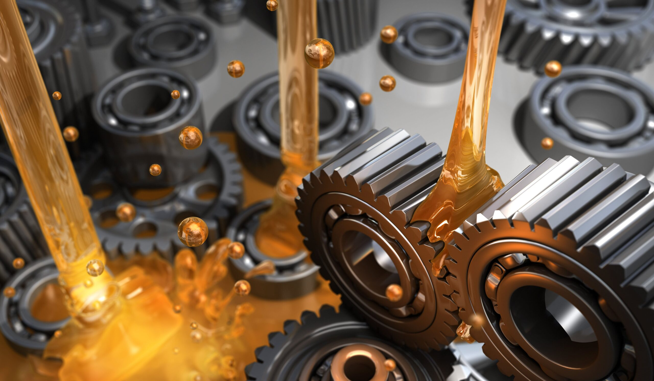
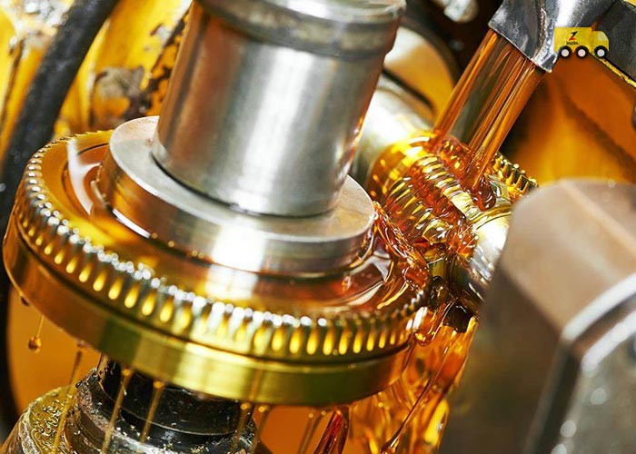
What is Lubricating Oil?
Lubricating Oil (=Lubricant, Lub. Oil, L.O.)
A fluid that forms a thin film between metal surfaces to reduce friction and wear, remove heat, and help machines operate smoothly.
1. Lubrication
Forms an oil film between metal surfaces to prevent direct metal-to-metal contact.
(Reduces friction → prevents wear → extends machine life.)
2. Cooling
Absorbs frictional and combustion heat generated from engines and bearings and transfers it to other areas. (Prevents overheating and thermal deformation.)

Slide 4
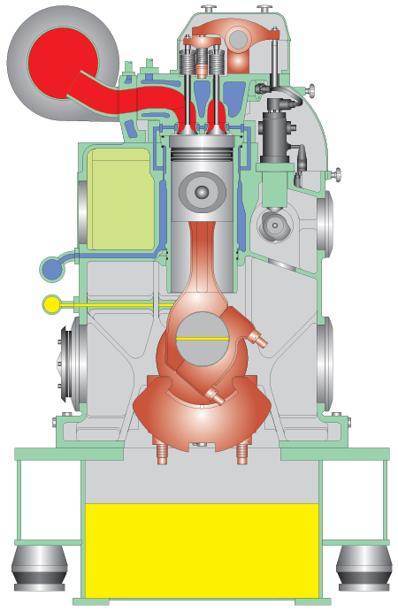
What is Lubricating Oil?
3. Cleaning
Impurities such as wear particles, carbon, and sludge adhere to the oil film, circulate, and are removed through a filter.
4. Sealing
Seals the gap between the piston ring and cylinder liner to prevent combustion gas leakage. Contributes to maintaining compression ratio and improving power output.
5. Corrosion & Rust Prevention
Forms a film on metal surfaces to protect them from oxygen, moisture, and combustion byproducts. Protection from acidic byproducts is particularly important in marine engines.
L.O in L.O sump tank

Slide 5
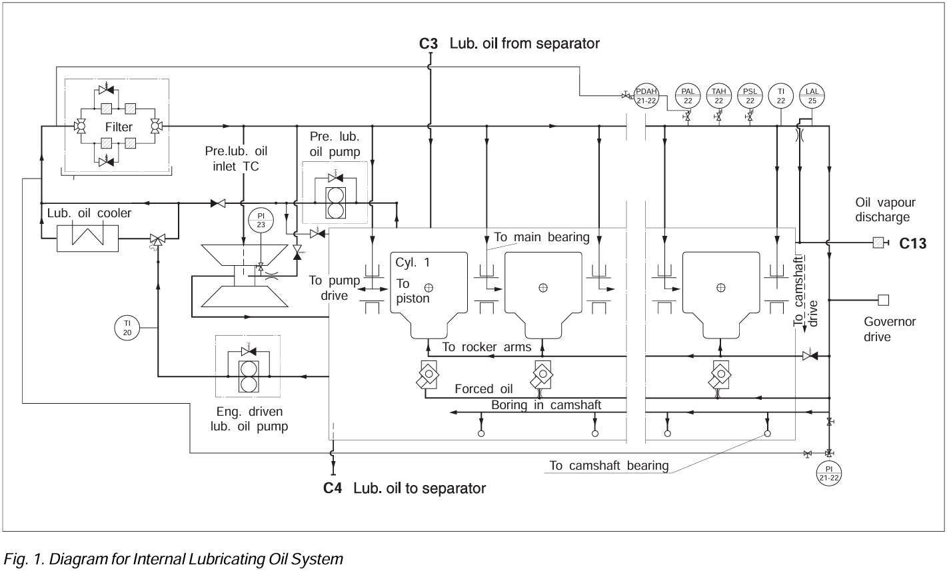
Internal Lubricating Oil System
The lubricating oil system is based on wet sump lubrication.
All moving parts of the engine are lubricated with oil circulating under pressure in a closed built-on system.
The lubricating oil is furthermore used for the purpose of cooling the pistons.

Slide 6

Internal Lubricating Oil System
The lubricating oil pump draws oil from the oil sump and presses the oil through the cooler and filter to the main lubricating oil pipe, from where the oil is distributed to the individual lubricating points.
From the lubricating points the oil returns by gravity to the oil sump.

Slide 7
Internal Lubricating Oil System
The main groups of components to be lubricated are:
1 - Turbocharger
2 - Main bearings, big-end bearings
3 - Camshaft drive
4 - Governor drive
5 - Rocker arms
6 - Camshaft

Slide 8
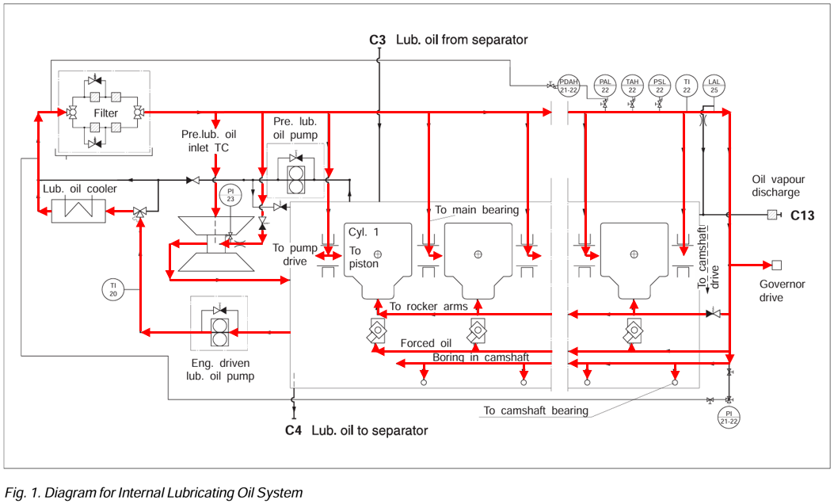
Internal Lubricating Oil System
For priming and during operation, the turbocharger is connected to the lub. oil circuit of the engine, the oil serves for bearing lubrication.
The inlet line to the turbocharger is equipped with a fixed throttle in order to adjust the oil flow and a non return valve to prevent draining during stand-still.
The non-return valve has back-pressure function requiring a pressure slightly above the priming pressure to open in normal flow direction. In this way overflooding of the turbocharger is prevented during stand-still periods, where the prelubricating pump is running.

Slide 9
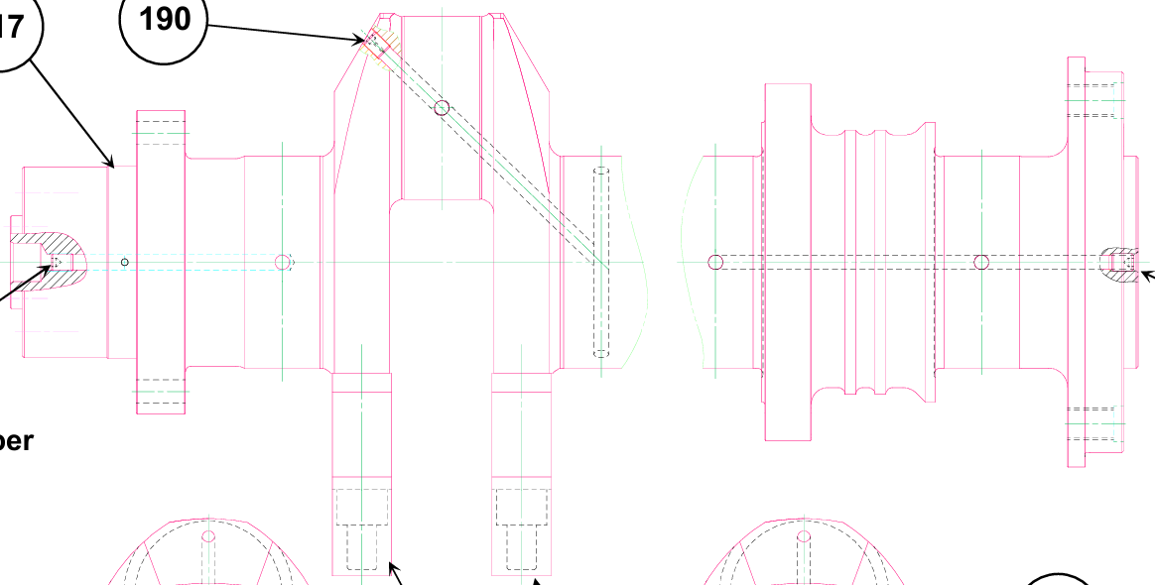
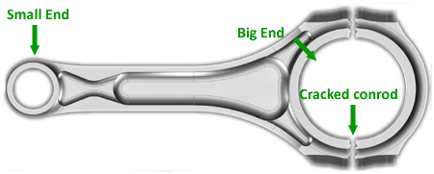
Internal Lubricating Oil System
Lubricating oil for the main bearings is supplied through holes drilled in the engine frame. From the main bearings it passes through bores in the crankshaft to the connecting rod big-end bearings.
The connecting rods have bored channels for supply of oil from the big-end bearings to the small-end bearings, which has an inner circumferential groove, and a pocket for distribution of oil in the bush itself and for supply of oil to the pin bosses and the piston cooling through holes and channels in the piston pin.
Crankshaft

Slide 10
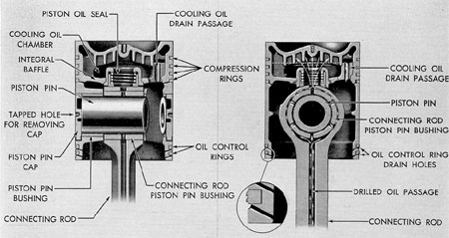
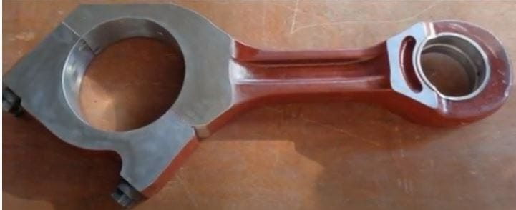
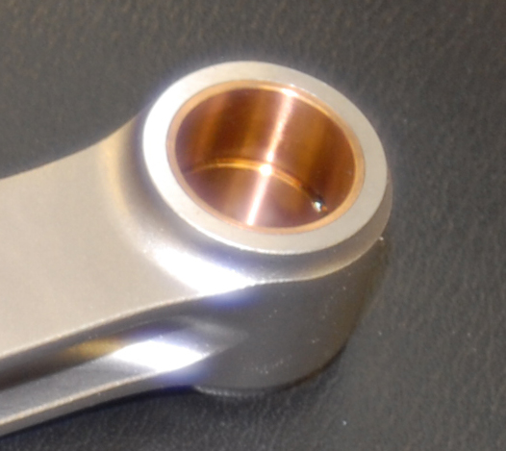
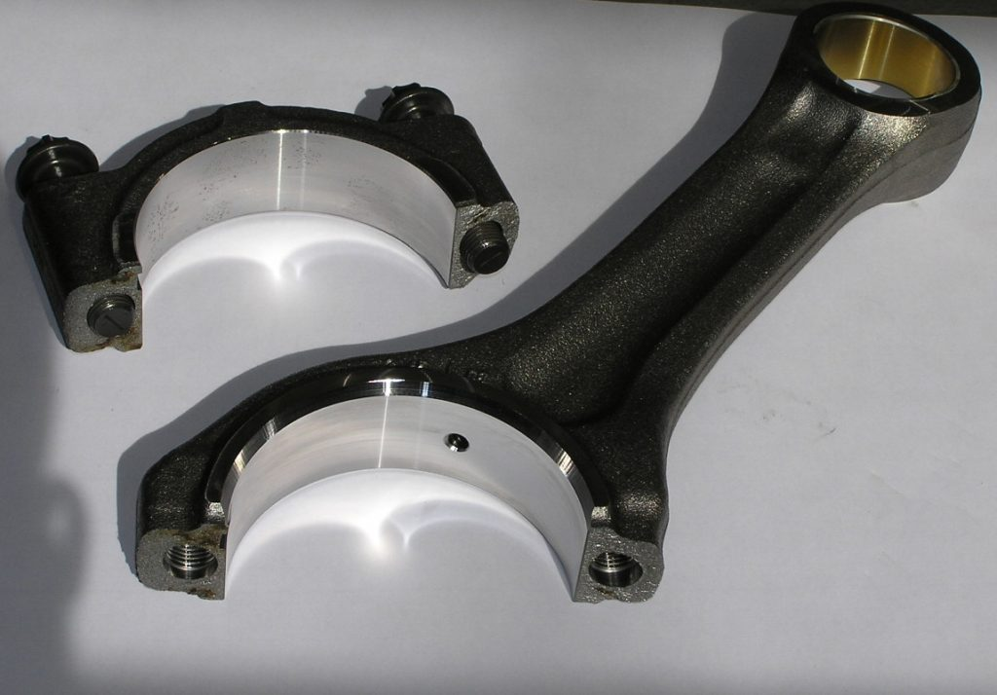
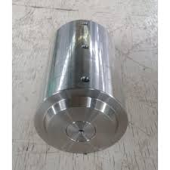
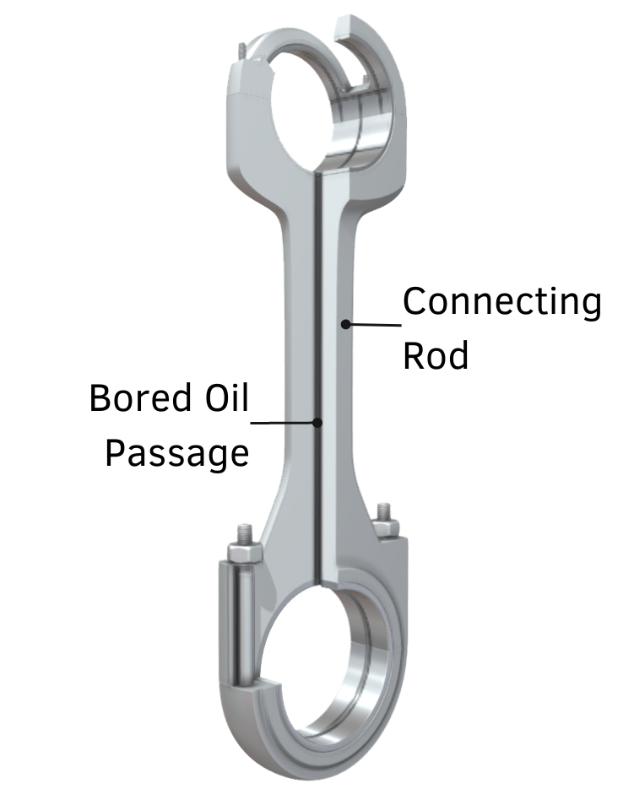
Internal Lubricating Oil System
The connecting rods have bored channels for supply of oil from the big-end bearings to the small-end bearings, which has an inner circumferential groove, and a pocket for distribution of oil in the bush itself and for supply of oil to the pin bosses and the piston cooling through holes and channels in the piston pin.
Piston pin

Slide 11
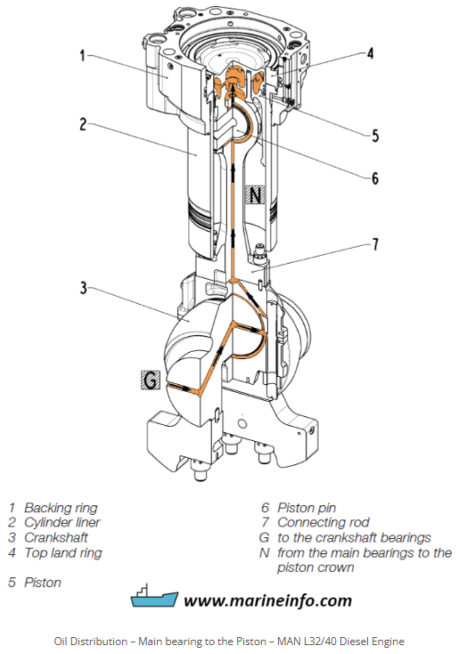
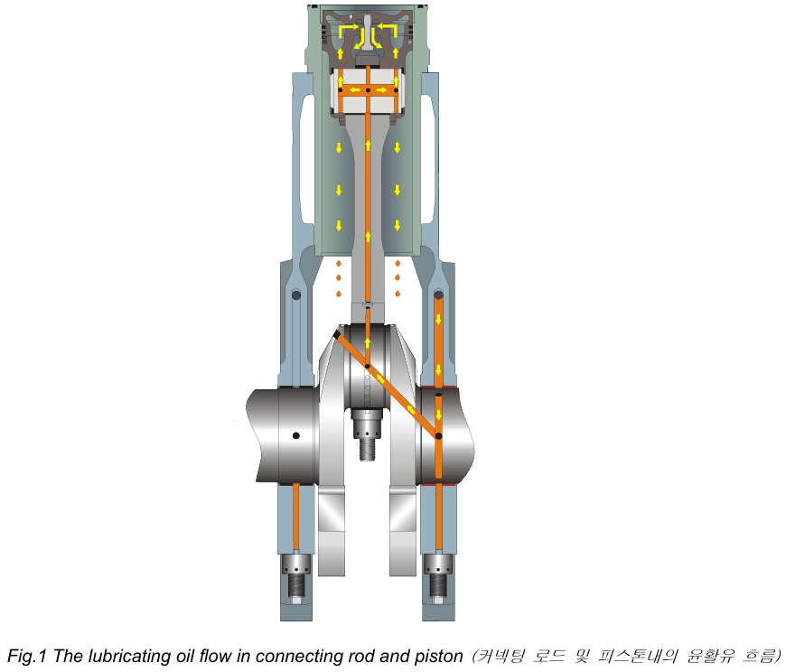
Internal Lubricating Oil System

Slide 12
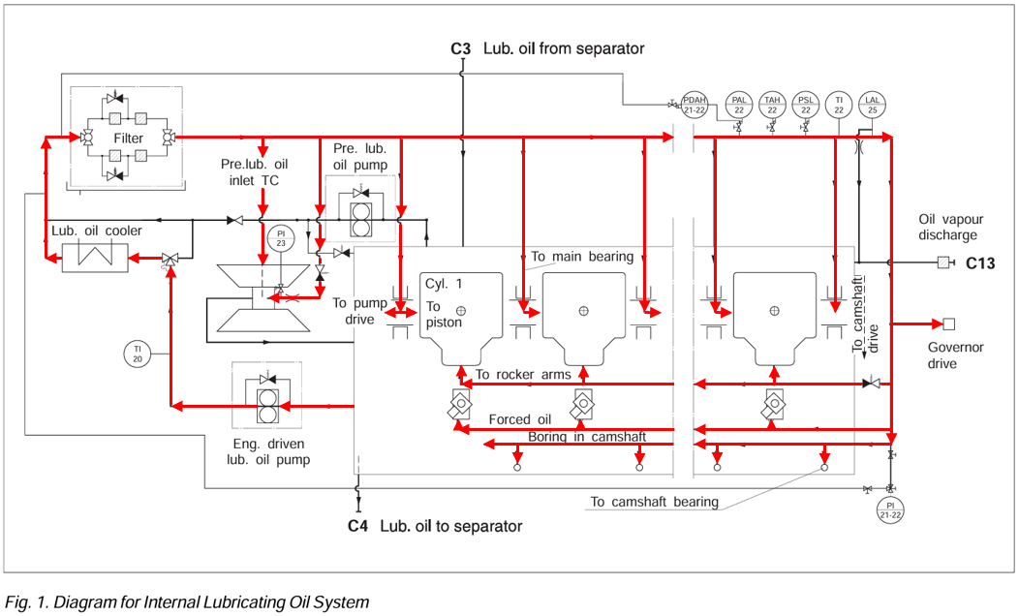
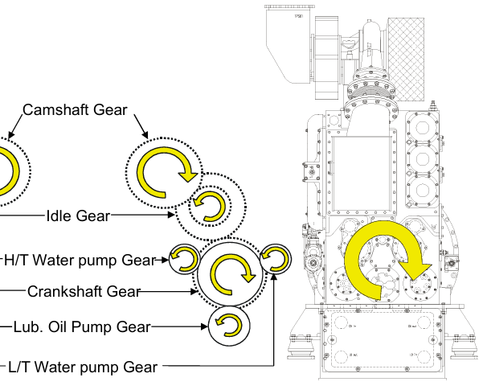
Internal Lubricating Oil System
From the front main bearings, channels are bored in the crankshaft for lubricating of the pump drive.

Slide 13
Internal Lubricating Oil System
The lubricating oil pipes, for the camshaft drive gear wheels, are equipped with nozzles which are adjusted to apply the oil at the points where the gear wheels are in mesh.
The lubricating oil pipe, and the gear wheels for the governor drive are adjusted to apply the oil at the points where the gear wheels are in mesh.

Slide 14
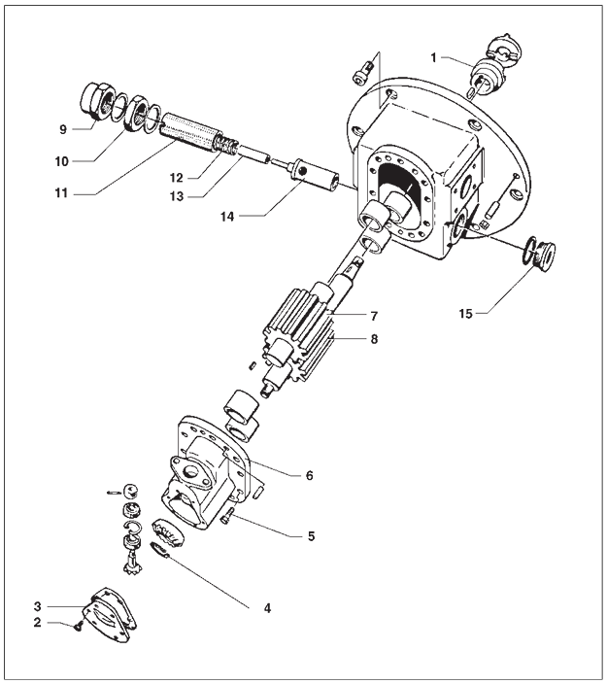
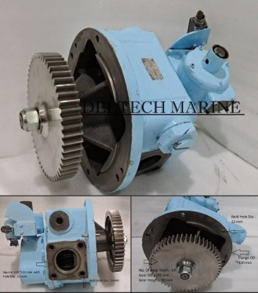
Engine driven lubricating oil pump
coupling
The lubricating oil pump, which is of the gear wheel type, is mounted on the front end of the engine and is driven by means of the crankshaft through a coupling or a gear wheel.
The pressure regulator forms part of the lubricating oil pump. Adjustment of the oil pressure is done by removing the cap nut and turning the adjusting screw.
Cap nut
Nut
Spring housing
Spring
Piston
Cylinder
Gear wheel
Plug screw
Cover
Screw
Locking ring
Screw

Slide 15
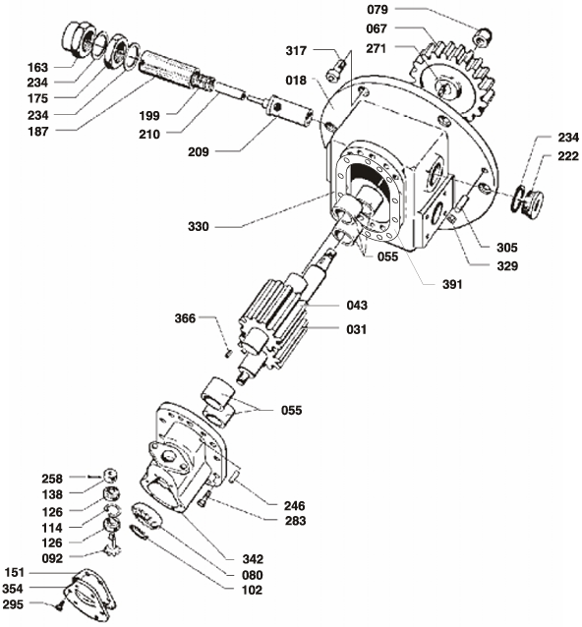
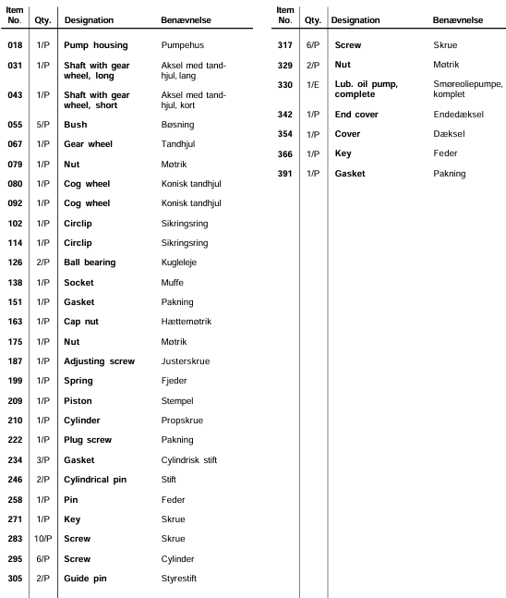
Engine driven lubricating oil pump

Slide 16
Pre lubricating pump

Slide 17
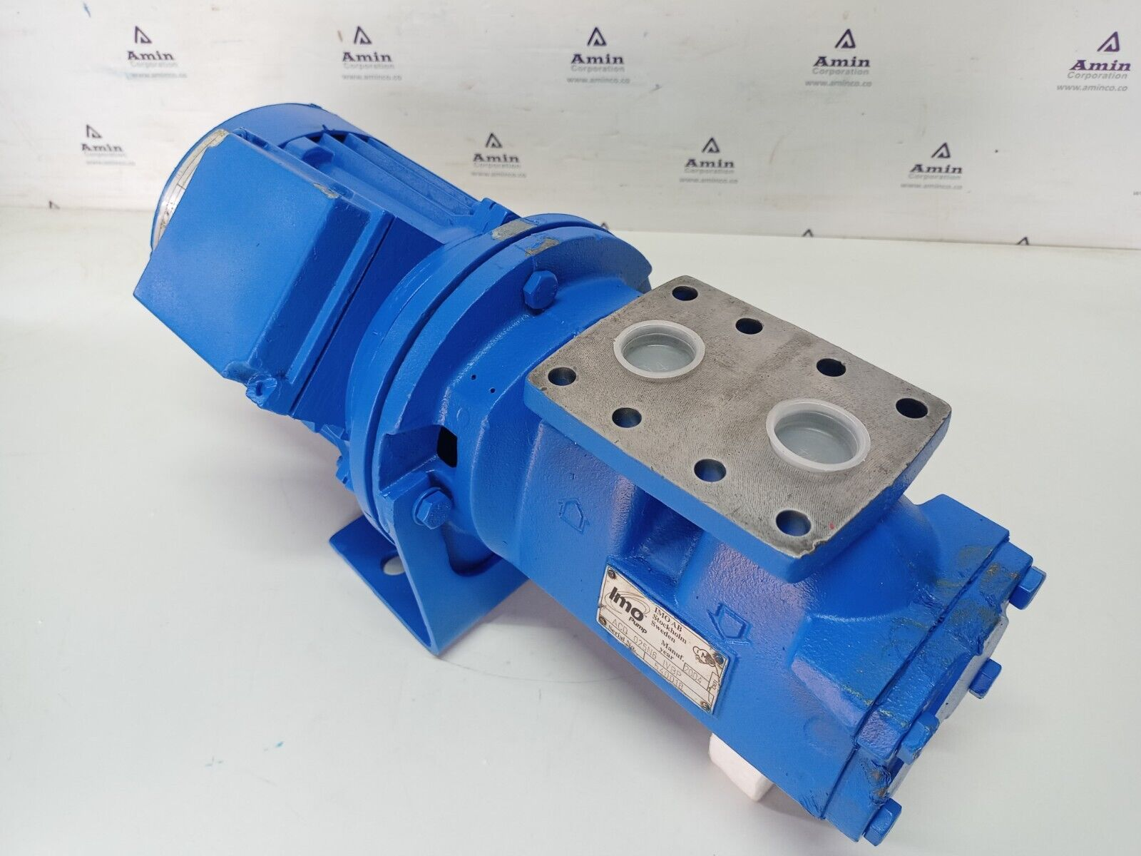
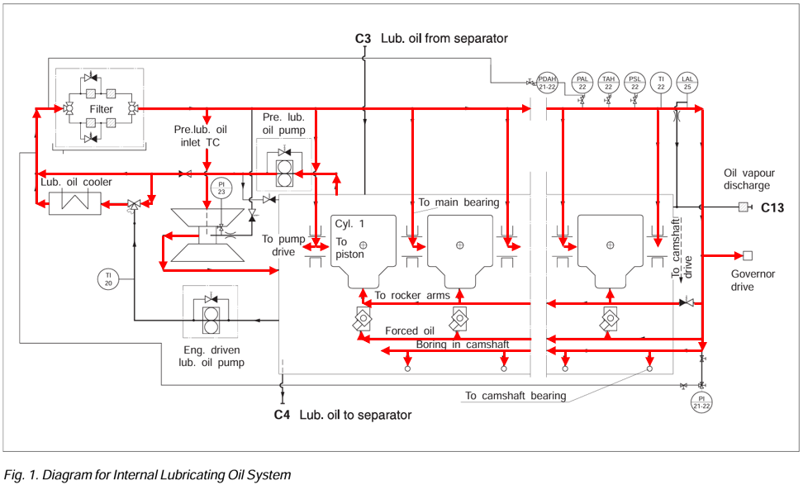
Pre lubricating pump
Flow out
Flow in
As standard, the engine is equipped with an electric driven pre lub. pump mounted parallel to the main pump.
The pump must be arranged for automatic operation, ensuring stand-still of the pre lubricating pump when the engine is running, and running during engine stand-still in stand-by position.
Notes:
stand-still : 정지

Slide 18
Pre lubricating pump
Running period of the pre lubricating pump is preferably to be continuous. If intermittent running is required for energy saving purpose, the timing equipment should be set for shortest possible intervals, say 2 minutes of running, 10 minutes of stand-still, etc.
Further, it is recommended that the pre lub. pump is led from the emergency switch board thus securing that the engine is not started without pre lubrication.
Notes:
intermittent : 간헐적인

Slide 19
Pre lubricating pump
The pre-lubricating pump must always be operated while the G/E is stopped to supply lubricating oil to each part of the G/E.
If the G/E is started without the pre-lubricating pump running, the crankshaft and bearings (connecting rod bearings and main bearings) will suffer severe damage, making it impossible to operate the G/E any longer.
2nd marine engineer must check that the L.O pressure of G/E is not zero (due to running of pre-lubricating pump) before starting G/E.

Slide 20
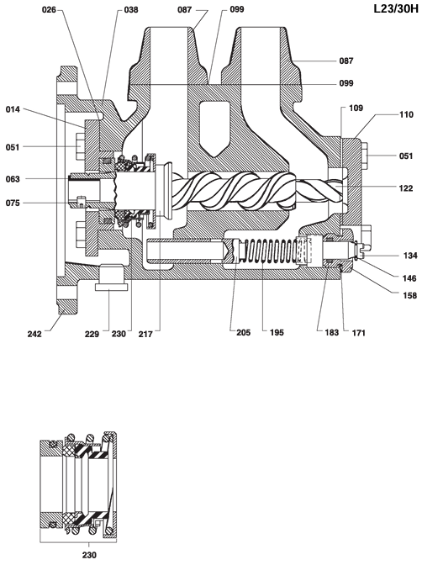
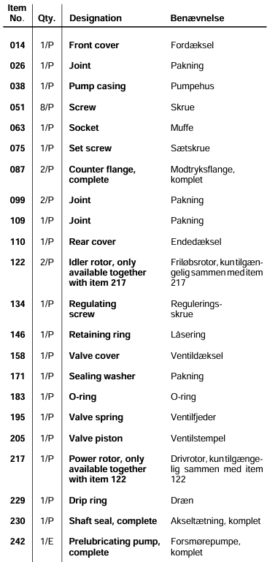
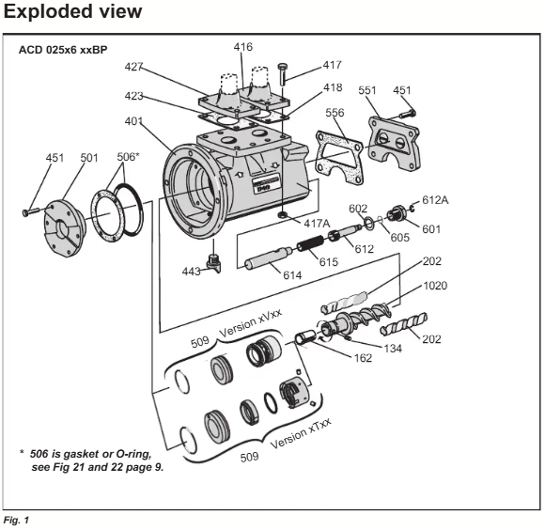
Pre lubricating pump
Flow out
Flow in
Idler rotor
Idler rotor
Power rotor
Idler rotor
Power rotor

Slide 21
Pre lubricating pump
Driving Screw (Power Rotor)
A central screw that rotates directly connected to a motor.
Driven Screws (Idler Rotors)
Two auxiliary screws that mesh with the driving screw and rotate together.
Casing
Encloses the screws and forms a fluid flow path.
Idler rotor
Power rotor
Idler rotor
Notes:
Mesh : 맞물리다

Slide 22
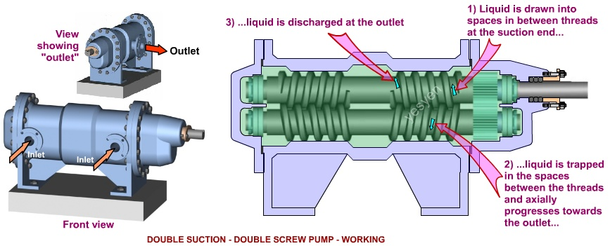
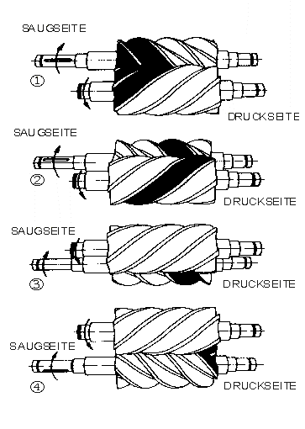
Pre lubricating pump
Principle of twin screw pump

Slide 23
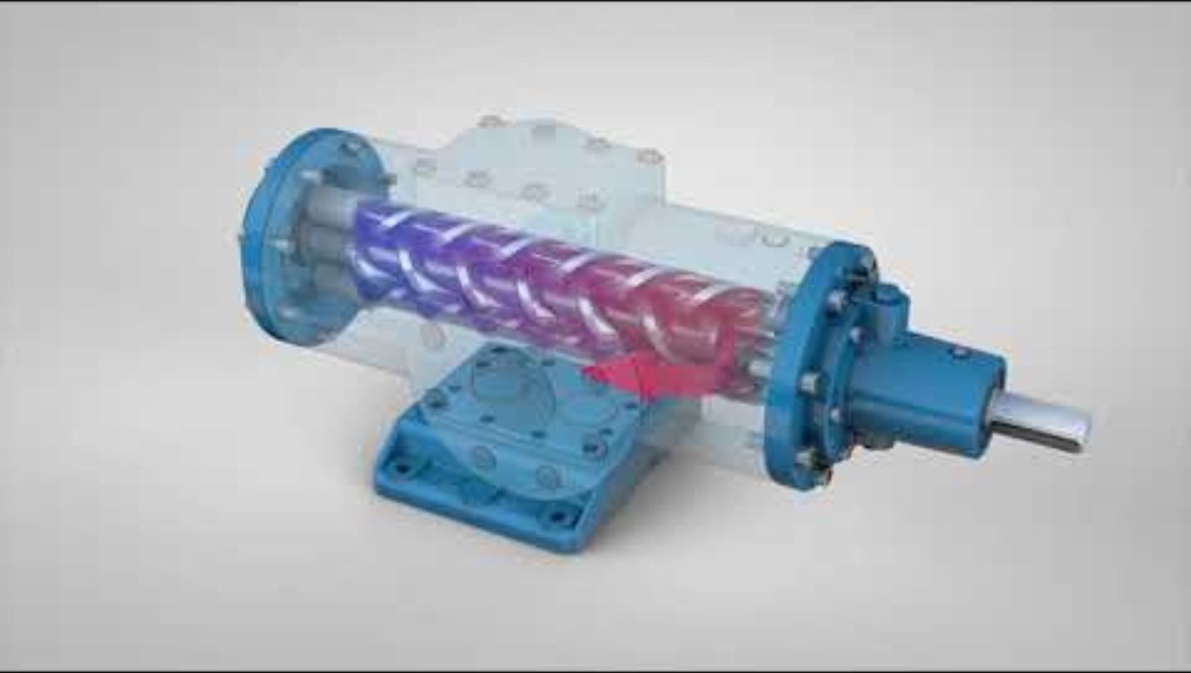
Pre lubricating pump
Principle of triple screw pump

Slide 24
Pre lubricating pump
Suction Phase
As the driving screw rotates, the two meshed driven screws also rotate in the opposite direction. This creates a sealed space (pocket) between the screw teeth and the housing wall. As this space expands at the pump inlet, fluid is sucked in. (As the enclosed space expands with rotation, its internal pressure drops, sucking fluid from the pump inlet.)
Transport Phase
As the screws rotate, the sealed spaces (pockets) move axially (along the length of the screw). During this process, the fluid is transported toward the outlet at a constant velocity without compression. (At this time, the fluid is pushed out without being compressed and maintaining a nearly constant volume.)
Discharge Phase
As the sealed spaces disappear at the screw tips, the fluid is forced toward the outlet. Since multiple pockets move continuously, the flow rate remains constant with minimal pulsation. (When the confined space reaches the outlet, the fluid inside experiences a pressure buildup because there is no further room for the space to move forward and the outlet is blocked. This pressure buildup ultimately pushes the fluid out with a force greater than the external piping/system pressure.)

Slide 25
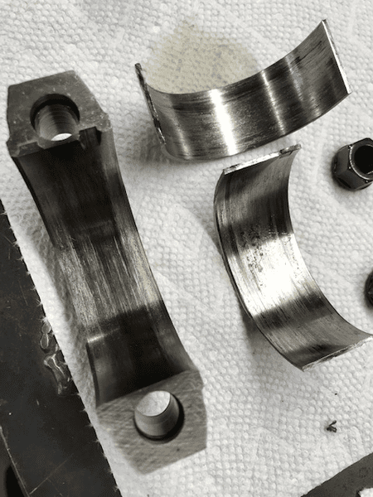
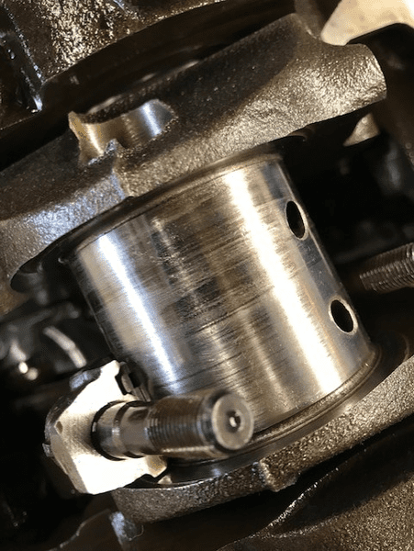
Pre lubricating pump
Wear of connecting rod bearing
Wear of crank pin

Slide 26
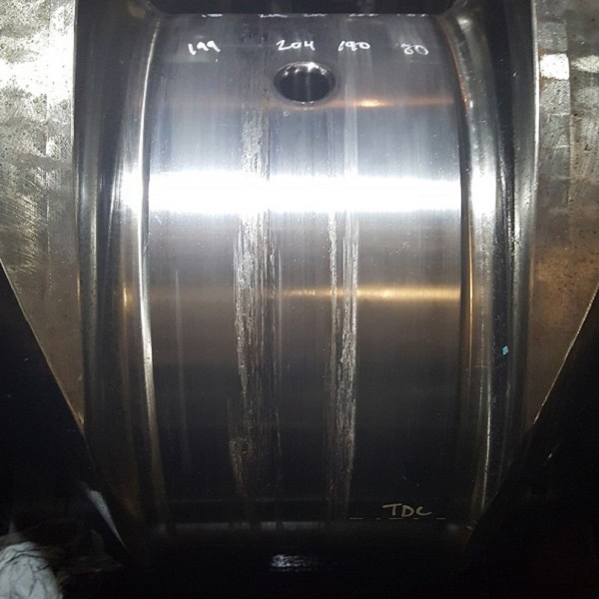
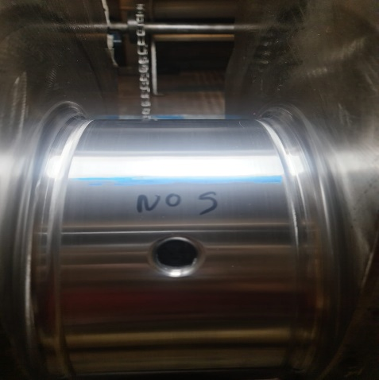
Pre lubricating pump
Wear of crank pin
The crank pin on the new crankshaft is shiny.

Slide 27
Lubricating Oil Filter

Slide 28
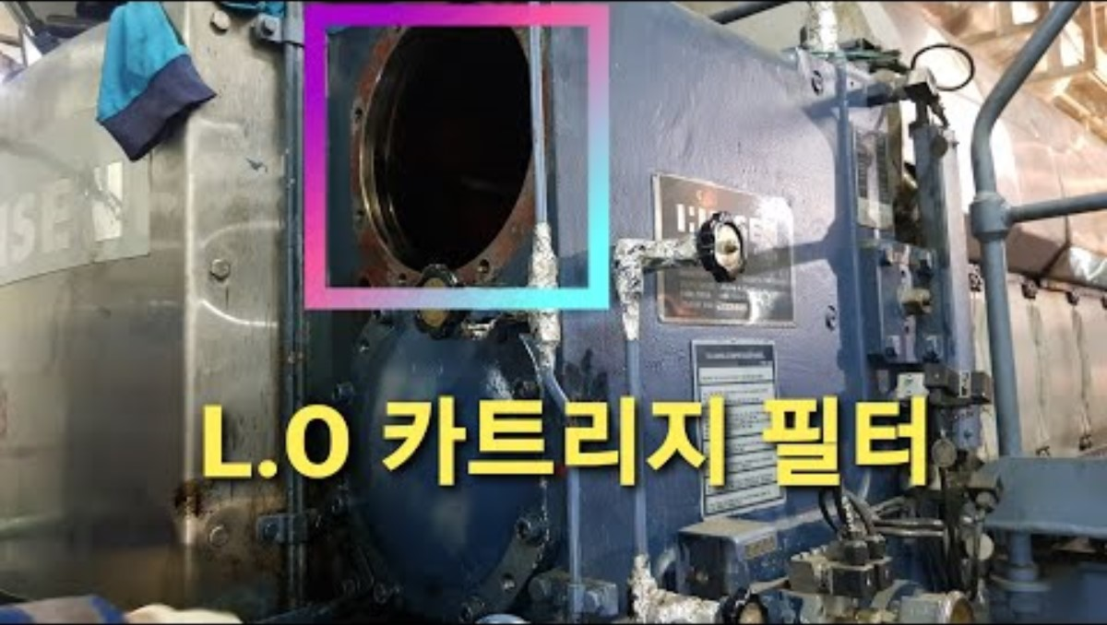
Lubricating Oil Filter (HiMSEN)

Slide 29
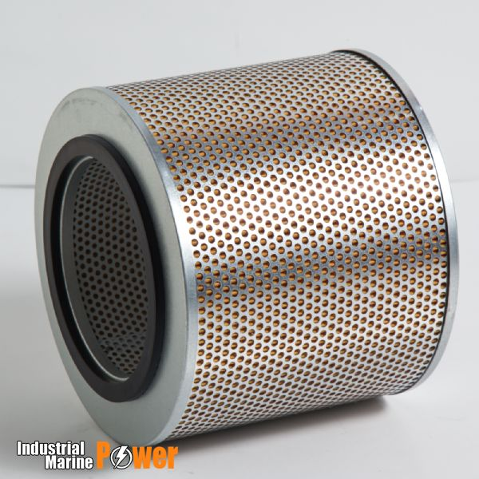
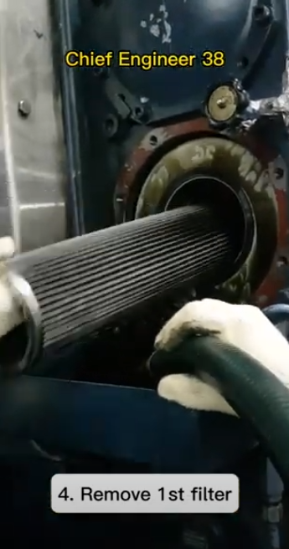
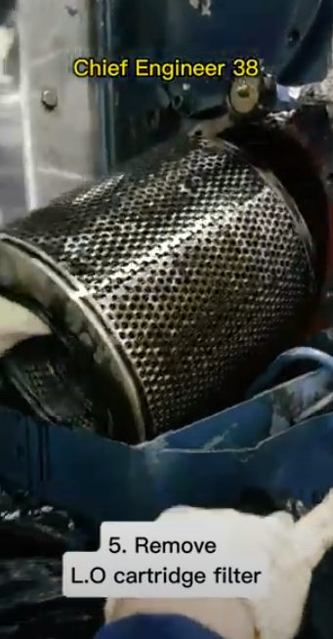
Lubricating Oil Filter
Filter basket (central element)
The lubricating oil filter is a double filter which is generally used with only one filter chamber being in operation, the other filter chamber being stand-by.
If the filter chamber in operation needs to be serviced, the operation can be switched to the other filter chamber without any interruption in lubricating oil supply to the engine.
Each filter chamber is equipped with 1 or 2 replaceable paper cartridges of fineness 10-15 microns.
In the center of each filter chamber a filter basket (central element) is situated. This filter basket is acting as a safety filter, having a fineness of about 60 microns.
Paper cartridges

Slide 30
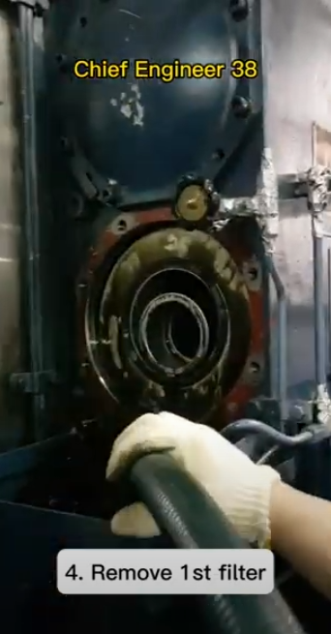
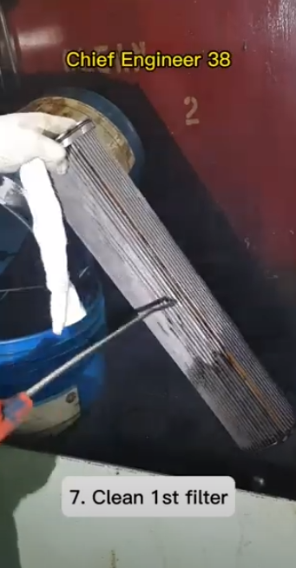
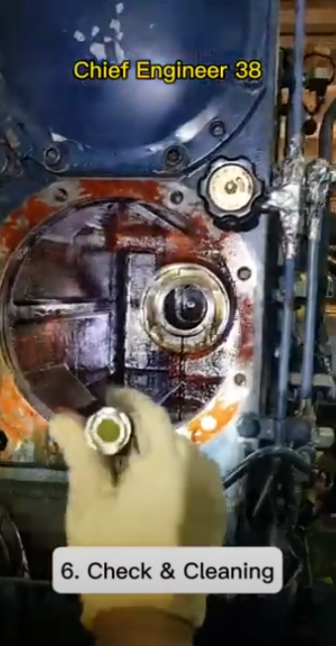
Lubricating Oil Filter
During operation, an increased pressure drop across the filter will be observed as dirt particles will deposit on the filtration surfaces of the paper cartridges and thus increase the flow resistance through the filter.
To ensure safe filtering of the lubricating oil, none of the by-pass valves must open during normal service and the elements should be replaced at a pressure drop across the filter of 1.5 bar.
When exchanging cartridges, it is advisable to release any old oil remaining in the filter housing by means of the drain plug provided for this purpose, and to wipe out the housing with a cloth.

Slide 31
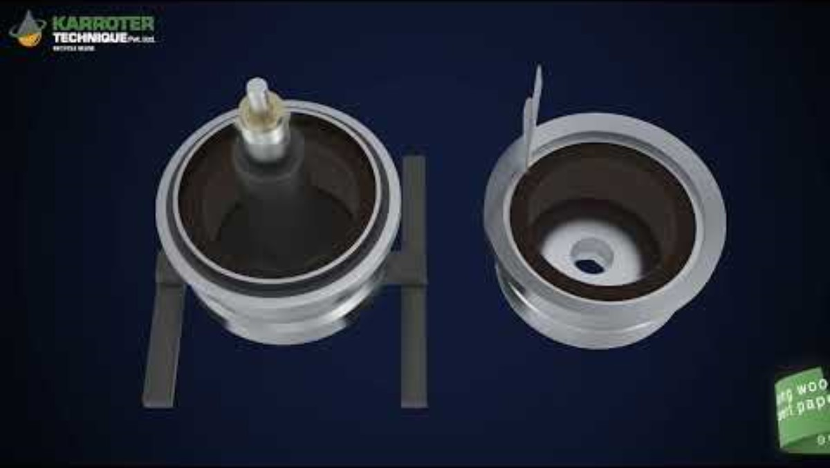
Centrifugal Oil Filter

Slide 32
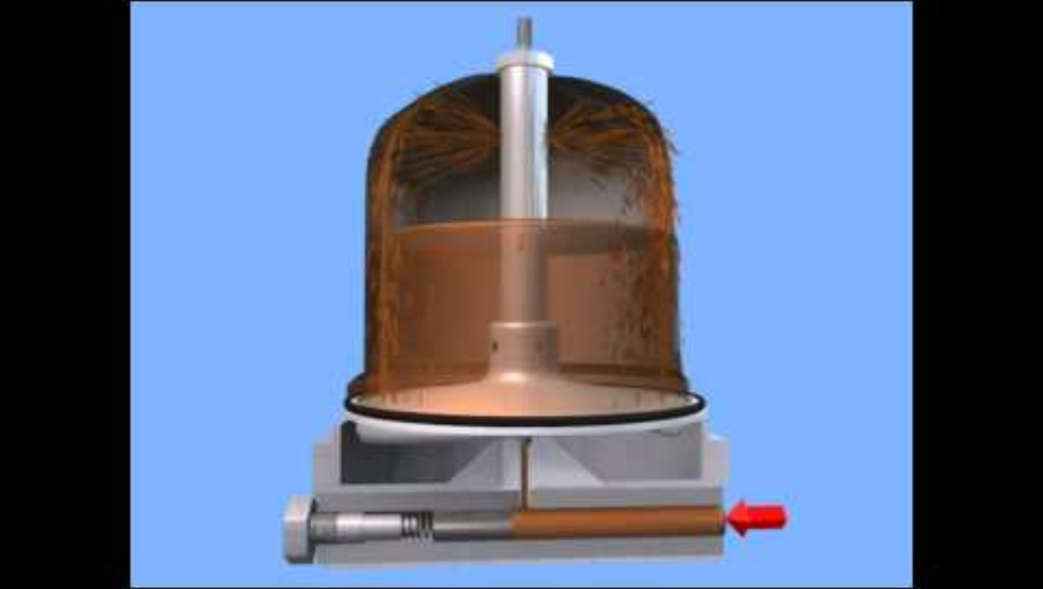
Centrifugal Oil Filter

Slide 33
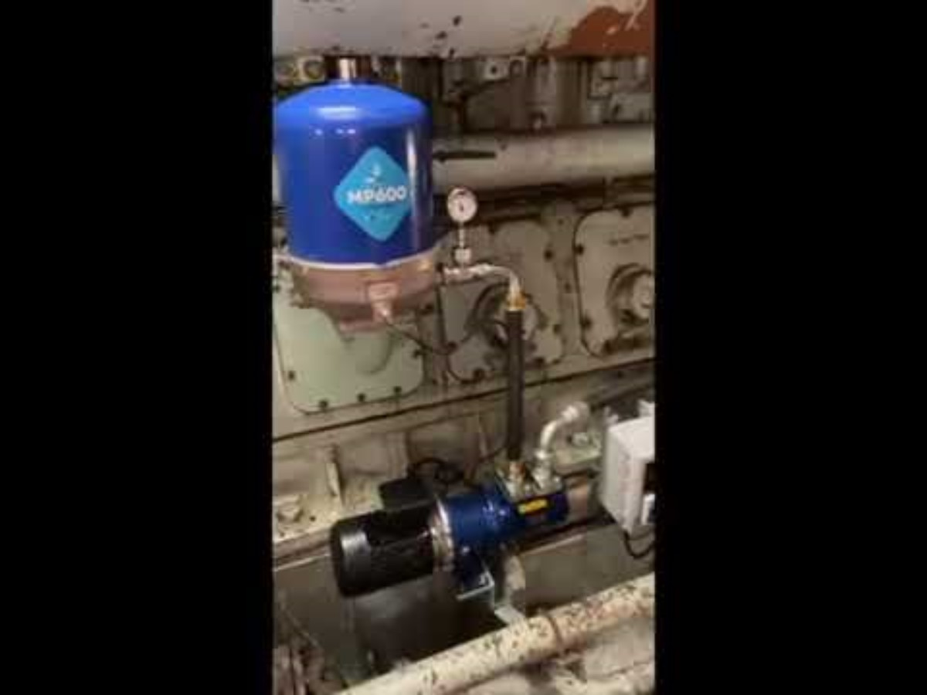
Centrifugal Oil Filter

Slide 34
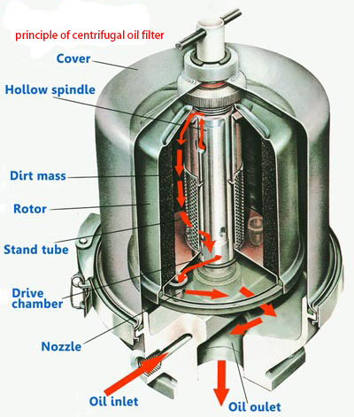
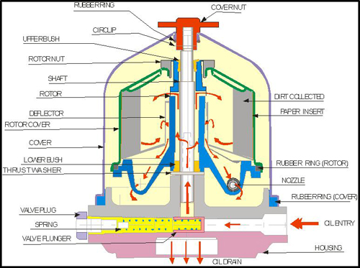
Centrifugal Oil Filter

Slide 35
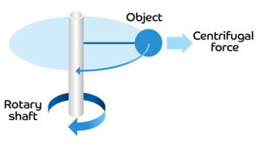

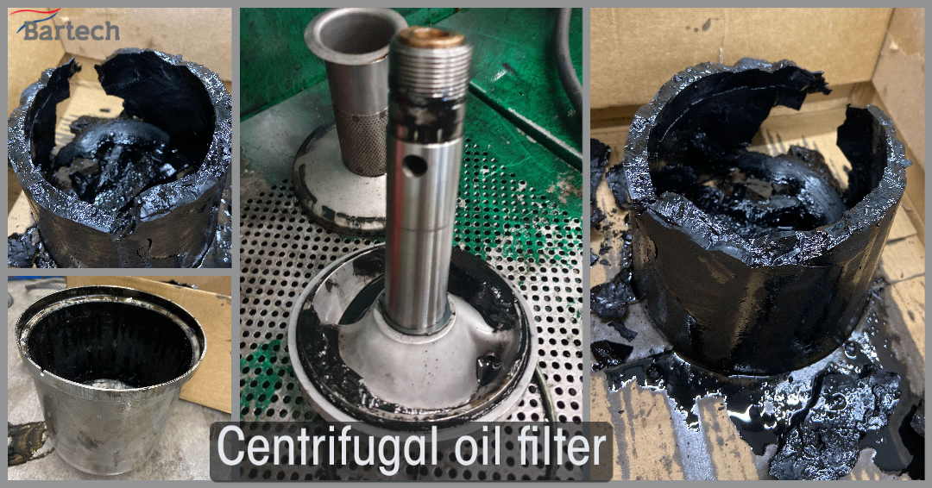
Centrifugal Oil Filter
Cover of the centrifugal oil filter
Paper cartridge
As the rotor rotates, centrifugal force is applied, causing heavy impurities such as sludge, metal particles, and carbon deposits in the oil to adhere to the rotor walls. (Similar to the principle used in washing machines.)
Accordingly, clean oil returns to the G/E L.O. sump tank by gravity.
To more easily separate the carbon deposits stuck inside the centrifugal oil filter, a thin paper cartridge is installed inside the cover of the centrifugal oil filter.
Carbon deposits

Slide 36
Centrifugal Oil Filter
Oil Inflow
Oil from the engine enters the filter rotor under pressure.
The oil enters through the rotor's central axis and collects within the rotor's internal space.
Nozzle (Jet) Structure
A very small jet orifice is located on the bottom or side of the rotor.
This nozzle is positioned slightly obliquely from the rotor center.
Jet Reaction (Newton's Third Law)
When oil is rapidly ejected through the nozzle under pressure,
the rotor rotates due to the reaction force of the ejected fluid's momentum.
Continuous Rotation
Since the engine oil pump continuously supplies oil, a continuous jet of oil is ejected from the nozzle.
As a result, the rotor rotates at high speeds (typically over several thousand RPM).
Notes:
Oblique : 사각
뉴턴 제3법칙 : 작용-반작용의 법칙

Slide 37
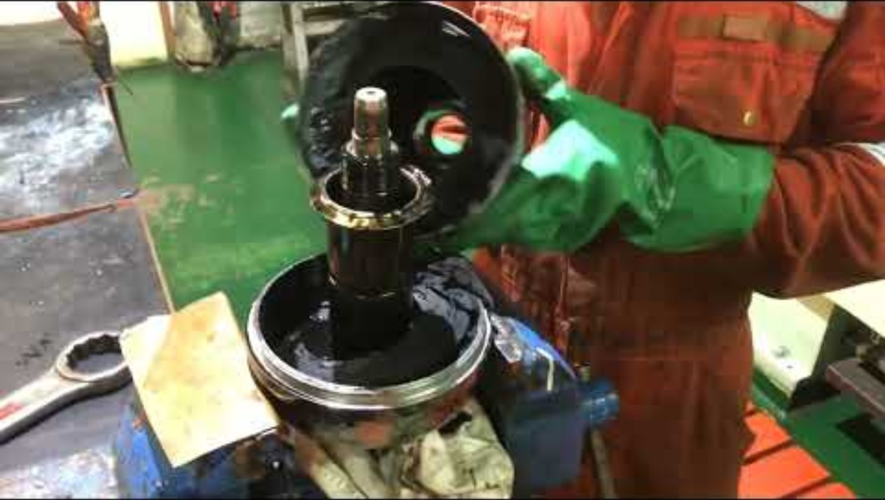
Centrifugal Oil Filter

Slide 38
L.O. transfer & purifying system for G/E
When the L.O of the G/E is severely contaminated, the L.O purifier can be operated to purify the L.O in the G/E L.O sump tank.
The L.O purifier can be operated continuously regardless of whether the G/E is in operation.
When the L.O purifier is in operation, it is necessary to consider the case where water is mixed into the purified L.O and goes to the G/E L.O sump tank, and the case where the L.O to be purified leaks from the L.O purifier and the amount of L.O in the G/E L.O sump tank decreases.

Slide 39
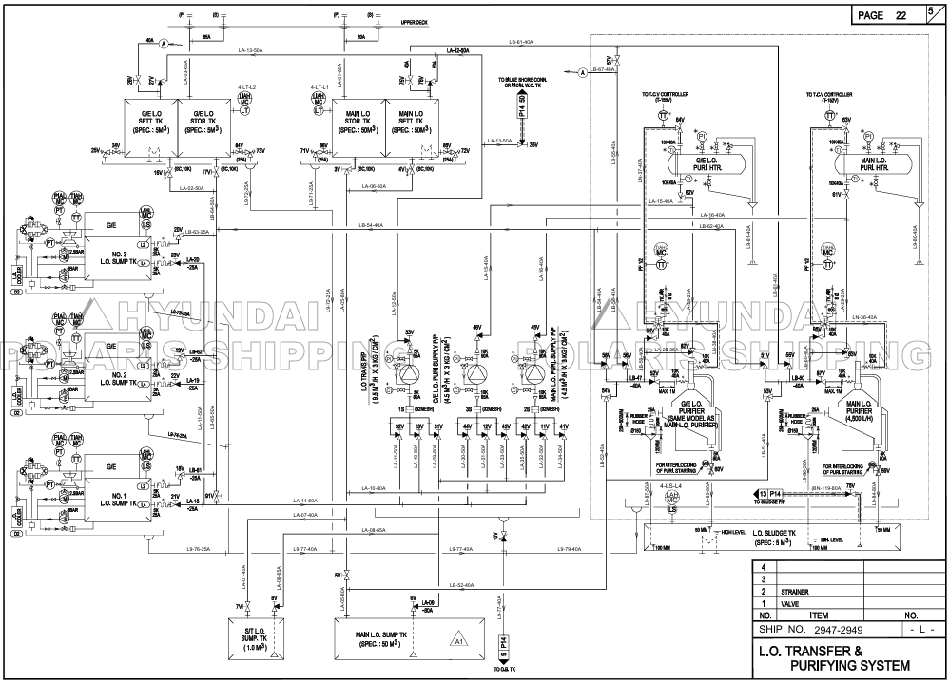

Slide 40
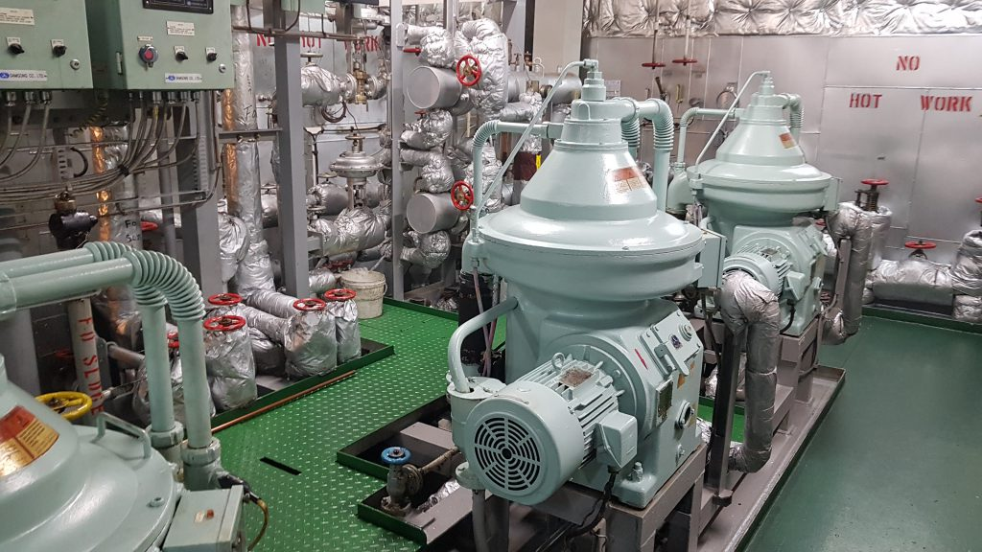
L.O. purifier

Slide 41

L.O. purifier

Slide 42

L.O. purifier

Slide 43

L.O. purifier

Slide 44

L.O. test onboard

Slide 45

L.O. test onboard

Slide 46

L.O. test onboard

Slide 47

L.O. test onboard

Slide 48
References
1) https://www.mosil.com/blog/industrial-lubricants/
2) https://www.nautilusshipping.com/news-and-insights/the-importance-of-marine-lubricants-and-engine-oils-for-ship-engine-optimization
3) https://www.lymmengineparts.co.uk/engine-bearings
4) https://www.highpowermedia.com/Archive/the-small-end-bearing
5) https://shamyadav.medium.com/best-tutorial-on-connecting-rod-of-marine-diesel-engine-99c350dbdad2
6) https://shamyadav.medium.com/best-tutorial-on-connecting-rod-of-marine-diesel-engine-99c350dbdad2
7) https://www.savree.com/en/encyclopedia/connecting-rod
8) https://www.ababilmarine.com/product/HYUNDAI-HIMSEN-8H21-32-CYLINDER-BLOCK-CR

Slide 49
References
9) https://maritime.org/doc/fleetsub/diesel/chap12.php
10) https://www.deltechmarine.com/latest-detail/man-b-w-6l23-30h-lub-oil-cooling-water-pump
11) https://www.kral.at/en/screw-pumps/lube-oil-applications/
12) https://www.forabodiesonly.com/mopar/threads/spun-360-rod-bearing.572108/
13) https://shop.aminco.co/products/imo-acd-025n6-ivbp-triple-screw-pump-0-5kw-electric-motor-refurbished-tested?srsltid=AfmBOopxf0iLYAo8BBLcePvRr2a7IIumf0BrTJqw7s02xU8SGo_qe_Yt
14) https://www.processtechacademy.com/screwing-it-up-with-screw-rotary-motion-pd-pumps/
15) https://en.wikipedia.org/wiki/Screw_pump
16) https://yesyen.com/screw_pump_working.php

Slide 50
References
17) https://www.youtube.com/watch?v=avCZVzmyBlg
18) https://separatorequipment.com/centrifugal-oil-cleaner/
19) https://bartechmarine.com/blog/does-your-engine-have-a-centrifugal-oil-filter/
20) https://www.youtube.com/watch?v=gn6hnWjnlhI
21) https://www.esummitsb.com/pages/engine%20attachment.html
22) http://hu.ruiqianfilter.com/info/main-classification-of-oil-filters-80409094.html
23) https://makeagif.com/gif/alfa-laval-centrifugal-separator-working-58iDiw
24) https://dolphincentrifuge.com/centrifugal-filter/

Slide 51
References
25) https://marineinfo.com/fuel-oil-purifier-system/
26) https://www.youtube.com/watch?v=luBKTsv3Lsg
27) https://www.youtube.com/watch?v=QWDB4UlOAJs
28) https://www.youtube.com/shorts/qHOdmhnkATc
29) https://www.youtube.com/watch?v=E5Vos8bqUYg
30) https://www.youtube.com/watch?v=RV8u7gV5oXQ
31) https://www.youtube.com/watch?v=7LOGCQHI64Y
32) https://www.youtube.com/watch?v=0lSymOdy0ok
33) https://marineinfo.com/auxiliary-engine-lubricating-oil-system/

